Slide 1
CS1010X Lecture 4:
Recursion vs Iteration
&
Order of Growth
Notes:
Lecture 4a video

Slide 2
Quick Review
Lecture 1: get to know Python
Lecture 2: solve with a single function / abstraction
Lecture 3: solving with many functions…
Lecture 4:
(a) solving in recursion vs iteration, and
(b) how good is your solution (time and space)

Slide 3
Understanding Recursion:
Base case(s)
Recursive (smaller) problem(s)
3. Baggage(s) to carry along

Slide 4
Recursion :
- Base cases : how they are finally solved
- Smaller problems : how their solutions are combined
Recursion Revisited
Recursion as a form of wishful thinking:
- Smaller problems have the same structure
as the original problem
Examples:
- Eg #1: Factorial (Linear Recursion)
- Eg #2: Fibonacci Numbers (Exponential Recursion)

Slide 5
Mathematical Induction vs Recursion
Mathematical Induction:
Start with a base case b
Come up with a procedure to show that if k and <k works, k+1 also works
Therefore, it must always work for all case ≥ b.
Recursion:
Derive a procedure to express a problem of size n as problem(s) of size k < n
Show that there exist a simple base case(s) b for which we have the answer
Procedure can therefore compute problem for all n ≥ b
Notes:
Not included in the video

Slide 6

Eg #3: Greatest Common Divisor (GCD)
Euclid’s Algorithm on gcd(a, b)
Input: a and b with a > b
We have:
  gcd(a, 0) = a
  gcd(a, b) = gcd(b, r), for a & b > 0
where r = a % b …is the remainder of a //b

Slide 7
Eg #3: Greatest Common Divisor (GCD)
GCD(206,40) = GCD(40,6)
= GCD(6,4)
= GCD(4,2)
= GCD(2,0)
= 2
Getting smaller problem
by looking at a
def gcd(a, b):
if (b == 0):
return a
else:
return gcd(b, a % b)
  gcd(a, 0) = a
  gcd(a, b) = gcd(b, r), for a & b > 0

Slide 8
Eg #4:Towers of Hanoi
A
B
C
Given:
Obtain:
A to C
Rule: No bigger disc on top of smaller disc at all time
while moving
only one disc
at a time
Why is recursion: ignore the largest disc at the bottom, then we have a smaller problem

Slide 9
Eg #4:Towers of Hanoi
A
B
C
Given:
1:
A to C
Rule: No bigger disc on top of smaller disc at all time
while moving
only one disc
at a time
Why is recursion: ignore the largest disc at the bottom, then we have a smaller problem
A small tweak : target the smaller problem as one from A to B….never violate the rule as largest not moved

Slide 10
Eg #4:Towers of Hanoi
A
B
C
Given:
2:
A to C
Rule: No bigger disc on top of smaller disc at all time
while moving
only one disc
at a time
Why is recursion: ignore the largest disc at the bottom, then we have a smaller problem
A small tweak : target the smaller problem as one from A to B….never violate the rule as largest not moved
Then, move the biggest disc to C.

Slide 11
Eg #4:Towers of Hanoi
A
B
C
Given:
3:
A to C
Rule: No bigger disc on top of smaller disc at all time
while moving
only one disc
at a time
Why is recursion: ignore the largest disc at the bottom, then we have a smaller problem
A small tweak : target the smaller problem as one from A to B….never violate the rule as largest not moved
Then, move the biggest disc to C.
Then, treat the smaller problem (again) as one from B to C….never violate the rule again.

Slide 12
Eg #4:Towers of Hanoi
def move_tower(size, A, C, B):
if size == 0:
return True
else:
move_tower(size-1, A, B, C)
print("move top disk from", A, "to", C)
move_tower(size-1, B, C, A)
A
B
C
Think recursion: (1) Base case: nothing to do
(2) smaller problems of size n-1

Slide 13
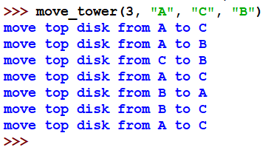
Eg #4:Towers of Hanoi
def move_tower(size, A, C, B):
if size == 0:
return True
else:
move_tower(size-1, A, B, C)
print("move top disk from", A, "to", C)
move_tower(size-1, B, C, A)
A
B
C
A
B
C

Slide 14
Eg #5: Counting Change
Make change for $1, using coins 50¢, 20¢, 10¢, 5¢, 1¢
e.g. 50¢ + 50¢,
  50¢ + 20¢ + 20¢ + 10¢,
  20¢ + 20¢ + 20¢ + 20¢ + 20¢,
  etc.
Assume unlimited number of coins available
Question: How many ways to change for $1?

Slide 15
Eg #5: Counting Change
Why recursion?
Can be divided into two (smaller) groups…
Under count?
No, everyone is counted for.
Over count?
No, everyone is in one of the two groups, not both.
50¢+50¢,
50¢+20¢+20¢+10¢,
…
+
20¢+20¢+20¢+20¢+20¢,
20¢+10¢+ …
Those that
do not use
any 50¢
Those that use
at least one 50¢

Slide 16
Eg #5: Counting Change
Why recursion?
Can be divided into two (smaller) groups…
given amount a, and n types of coins
Base cases?
a = 0, cc = 1
a < 0, cc = 0
n = 0, cc = 0
50¢+50¢,
50¢+20¢+20¢+10¢,
…
+
20¢+20¢+20¢+20¢+20¢,
20¢+10¢+ …
Those that
do not use
any 50¢
Those that use
at least one 50¢

Slide 17
Eg #5: Counting Change
Why recursion?
Can be divided into two (smaller) groups…
given amount a, and n types of coins
Base cases?
cc(0, n) = 1
a = 0, cc = 1
a < 0, cc = 0
n = 0, cc = 0
cc(a, 0) = 0
cc(a, n) =
cc(a – 50, n)
+
cc (a, n – 1)
Those that
do not use
any 50¢
Those that use
at least one 50¢

Slide 18
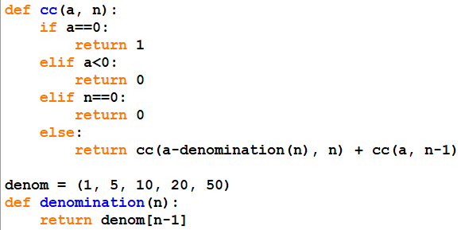
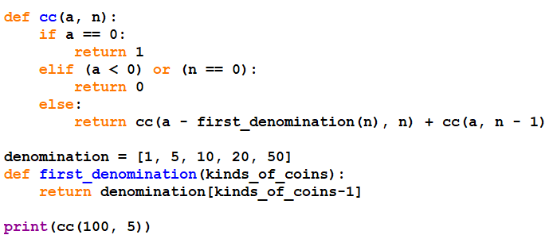
Eg #5: Counting Change
Why recursion?
Can be divided into two (smaller) groups…
given amount a, and n types of coins
Base cases?
a = 0, cc = 1
a < 0, cc = 0
n = 0, cc = 0
cc(a, n) =
cc(a – 50, n)
+
cc (a, n – 1)

Slide 19
Counting Change
once more
…understanding carrying baggage into recursion

Slide 20
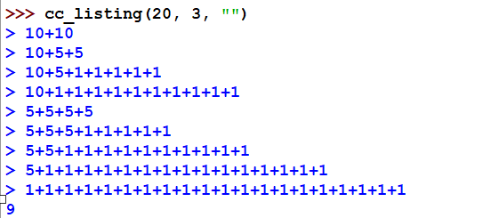
How can we list out the actual ways to do the change ?
These are the 9 ways
to change 20 cents

Slide 21
Eg #5: Counting Change - revisit
Why recursion?
Can be divided into two (smaller) groups…
given amount a, and n types of coins
Base cases?
a = 0, cc = 1
a < 0, cc = 0
n = 0, cc = 0
cc(a – 50, n, baggage)
+
cc (a, n – 1, baggage)

Slide 22
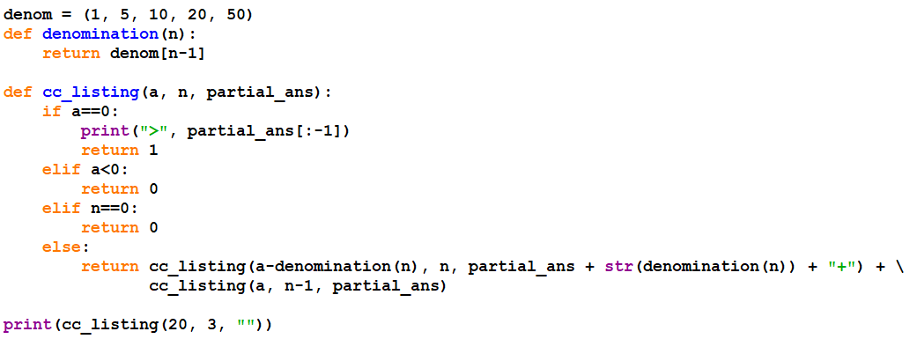
Eg #5: Counting Change - revisit
Why recursion?
Can be divided into two (smaller) groups…
given amount a, and n types of coins
Base cases?
a = 0, cc = 1
a < 0, cc = 0
n = 0, cc = 0
cc(a – 50, n, baggage)
+
cc (a, n – 1, baggage)

Slide 23
Recursion
Base case(s)
Recursive (smaller) problem(s)
3. Baggage(s) to carry along
Examples:
- Eg #1: Factorial (Linear Recursion)
- Eg #2: Fibonacci Numbers (Exponential Recursion)
- Eg #3: GCD (Linear Recursion / Tail Recursion)
- Eg #4: Towers of Hanoi (Exponential Recursion)
- Eg #5: Counting Change (Exponential Recursion)
* baggage(s) to carry along
* counting: no under count, and no over count

Slide 24
Understanding Iteration:
while
for … with range
3. recursion vs iteration

Slide 25
Recap #1: Factorial
Consider the factorial function:
n! = n x (n-1) x (n-2) … x1
Recursion thinking:
n! = 1 if n = 1
= n x (n-1)! if n > 1

Slide 26
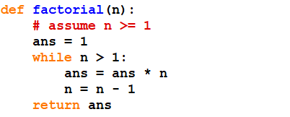
Recap #1: Factorial
Consider the factorial function:
n! = n x (n-1) x (n-2) … x1
Iterative thinking:
(1) start with n, multiply by (n-1), multiply by (n-2), …, by 2.
n
ans
5
1
4
5
3
20
2
60
1
120

Slide 27
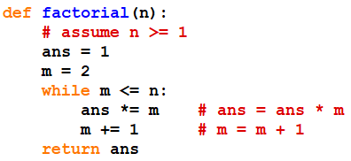
Recap #1: Factorial
Consider the factorial function:
n! = n x (n-1) x (n-2) … x1
Iterative thinking:
(1) start with n, multiply by (n-1), multiply by (n-2), …, by 2.
OR
(2) Start with 1, multiply by 2, multiply by 3,… multiply by n.

Slide 28
Recap #1: Factorial
Consider the factorial function:
n! = n x (n-1) x (n-2) … x1
Iterative thinking:
(1) start with n, multiply by (n-1), multiply by (n-2), …, by 2.
OR
(2) Start with 1, multiply by 2, multiply by 3,… multiply by n.
n
m
ans
5
2
1
3
2
4
6
5
24
6
120

Slide 29
Recap #1: Factorial
Consider the factorial function:
n! = n x (n-1) x (n-2) … x1
Iterative thinking:
(1) start with n, multiply by (n-1), multiply by (n-2), …, by 2.
OR
(2) Start with 1, multiply by 2, multiply by 3,… multiply by n.

Slide 30
while loop
while <expression>:
<body>
<expression>
  predicate to stay within loop
<body>
  statements to be evaluated when predicate <expression> is True

Slide 31
for loop
for i in range([start,] stop[, step])
<body>
<body> be evaluated once for each of
i = start, …, stop-1
with increment in interval of
step
E.g. range(0, 5)
that is 0, 1, 2, 3, 4
E.g. range(5)
means range(0, 5) too
E.g. range(1, 5, 2)
that is 1, 3
E.g. range(5, 1, -2)
that is 5, 3

Slide 32


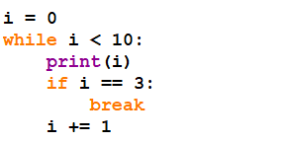
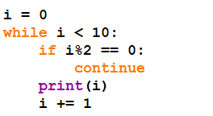
break & continue
break out of loop
skip current iteration
1
3
5
7
9
0
1
2
3
not quite the
equivalence

Slide 33
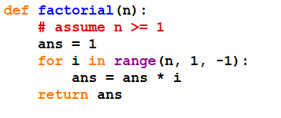
Recap #1: Factorial
Consider the factorial function:
n! = n x (n-1) x (n-2) … x1
Iterative thinking:
(1) start with n, multiply by (n-1), multiply by (n-2), …, by 2.
i
ans
1
5
5
4
20
3
60
2
120

Slide 34
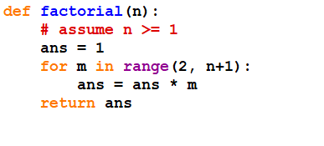
Recap #1: Factorial
Consider the factorial function:
n! = n x (n-1) x (n-2) … x1
Iterative thinking:
(1) start with n, multiply by (n-1), multiply by (n-2), …, by 2.
OR
(2) Start with 1, multiply by 2, multiply by 3,… multiply by n.
practise the tracing yourself…

Slide 35
Iterative process
n
ans
5
1
4
5
3
20
2
60
ans
1
120
i
1
5
5
4
20
3
60
2
120
same for recursion
Time: linearly proportional to n
Space: constant as no deferred operations
better than recursion

Slide 36
Iterative process
n
m
ans
5
2
1
3
2
4
6
5
24
n
m
ans
6
120
5
1
2
2
3
6
4
24
5
120
same for recursion
Time: linearly proportional to n
Space: constant as no deferred operations
better than recursion

Slide 37
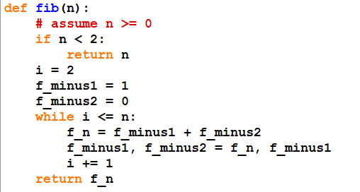
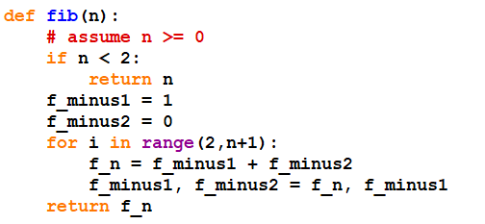
Recap #2: Fibonacci
f(0) = 0
f(1) = 1
f(n) = f(n-1) + f(n-2)
0, 1, 1, 2, 3, 5, 8, 13, …
Iterative Thinking: (only 1 direction possible)
Start with 0 and 1, and then gradually sum to get f(2), then f(3), …
while loop
for loop

Slide 38
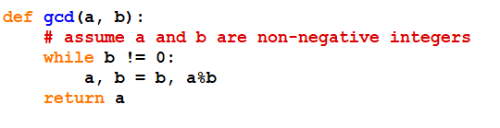
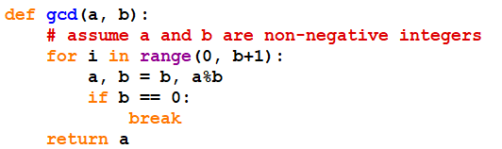
Recap #3: GCD
gcd(a, 0) = a
gcd(a, b) = gcd(b, r) where r = a % b
Iterative Thinking: (only 1 direction possible)
keeping track of a, b, r along the way till b = 0
while loop
for loop

Slide 39
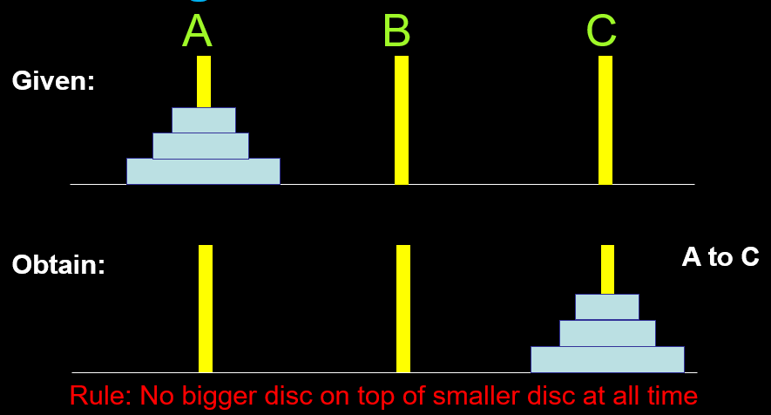
Recap #4: Towers of Hanoi
Iterative Thinking: ?
keeping track of progress in stack….

Slide 40
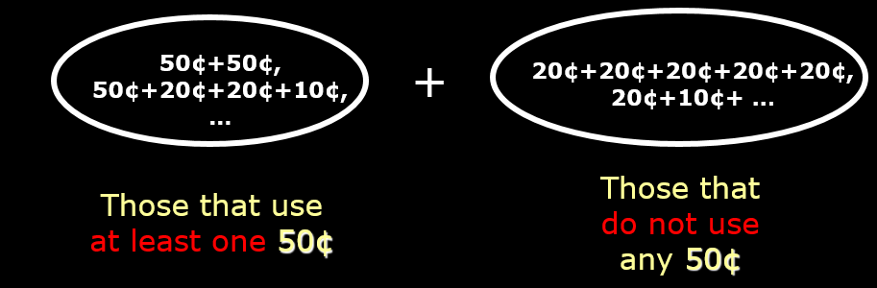
Recap #5: Changing Coins
Iterative Thinking: ?
keeping track of progress in stack….
Iterative Thinking: ?
keeping track of progress in stack….?
different idea to do well…

Slide 41
Recursion vs
Iteration

Slide 42
Difference
Recursive process
occurs with deferred/pending operations
system handles it for our convenience
( stack / activation record )
Iterative process
no deferred operations
normal routine as in languages

Slide 43
Difference
Recursive process
Can be conceptually easy to obtain soln
can be expensive (time/space)
Iterative process
Can be more efficient than recursion
hard to do ourselves to handle stack
e.g. iterative solution for towers of hanoi, counting change?

Slide 44
For this course…
Don’t hesitate to write recursive processes.
Leave the optimization to the interpreter.

Slide 45
Order of Growth
…understanding good vs bad
program / algorithm
Notes:
Lecture 4c video

Slide 46
Algorithm
vs
Program

Slide 47
There are many ways to solve a (computational) problem
…how do we know what is good vs bad?
Time
&
Space
Notes:
.

Slide 48
What to consider ?
Time : how long it takes to run a program
Space : how much memory it needs to run
But then, there are many different kinds of computers, so
which computers are we talking about time….
There are various possible inputs to handle…what time or space
are you talking about…
To be objective, talk with no specific computers, but
GROWTH rate with reference to the
SIZE of input

Slide 49
What to consider ?
Time : how long it takes to run a program
Space : how much memory it needs to run
But then, there are many different kinds of computers, so
which computers are we talking about time….
Again, talking absolute numbers is not very meaningful
We talk of ORDER of GROWTH w.r.t SIZE of input
To be objective, talk with no specific computers, but
GROWTH rate with reference to the
SIZE of input

Slide 50
We want to ask questions like:
factorial(5) → factorial(10) ?
fib(10) → fib(20)?
How much more time?
How much more space?
2x?
Same?
4x?
Order of Growth w.r.t Size…i.e. F(size)

Slide 51
Orders of Growth
Let n denote size of the problem.
Let R(n) denote the resources needed.
Definition:
  R(n) has order of growth Θ( f(n) ), written
  R(n) = Θ( f(n) )
  if there are positive constants k₁ and k₂ such that
  k₁ f(n) ≤ R(n) ≤ k₂ f(n)
  for any sufficiently large value of n

Slide 52
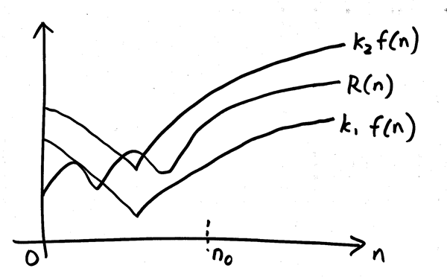
Diagram
upper boundO(f(n))
Θ(f(n))
lower
boundΩ(f(n))
For n ≥ n₀, R(n) is sandwiched between
i.e. k₁ f(n) ≤ R(n) ≤ k₂ f(n)

Slide 53
Intuitively, it means that if
n is doubled
(i.e. increased to 2n),
then the resource required, R(n), is increased to f(2n)
Notes:
Not in the video

Slide 54
Some common f(n)
1
n
n²
n³
log n
n log n
2^{n}

Slide 55
Some common f(n)
logarithmic
log n
n log n
Getting
non-practical
1
n
n²
n³
2^{n}
constant
linear
quadratic
cubic
exponential

Slide 56
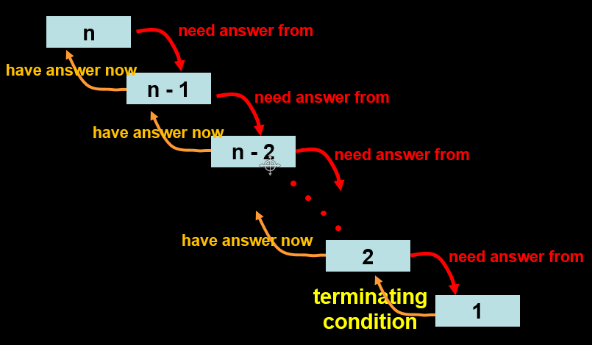
Recursive process
factorial(6)
6 * factorial(5)
6 * 5 * factorial(4)
6 * 5 * 4 * factorial(3)
6 * 5 * 4 * 3 * factorial(2)
6 * 5 * 4 * 3 * 2 * factorial(1)
6 * 5 * 4 * 3 * 2 * 1
6 * 5 * 4 * 3 * 2
6 * 5 * 4 * 6
6 * 5 * 24
6 * 120
720
Time ∝ #operations
O(n)
Linearly proportional to n

Slide 57
Recursive process
factorial(6)
6 * factorial(5)
6 * 5 * factorial(4)
6 * 5 * 4 * factorial(3)
6 * 5 * 4 * 3 * factorial(2)
6 * 5 * 4 * 3 * 2 * factorial(1)
6 * 5 * 4 * 3 * 2 * 1
6 * 5 * 4 * 3 * 2
6 * 5 * 4 * 6
6 * 5 * 24
6 * 120
720
Space ∝ # pending operations
O(n)
Linearly proportional to n

Slide 58
Iterative process
n
ans
5
1
4
5
3
20
2
60
ans
1
120
i
1
5
5
4
20
3
60
2
120
O(n)
same for recursion
Time: linearly proportional to n
Space: constant as no deferred operations
better than recursion
O(1)

Slide 59
Iterative process
n
m
ans
5
2
1
3
2
4
6
5
24
n
m
ans
6
120
5
1
2
2
3
6
4
24
5
120
O(n)
same for recursion
Time: linearly proportional to n
Space: constant as no deferred operations
better than recursion
O(1)

Slide 60
Problem | Recursive Solution | Iterative Solution
Factorial (n) | Time: O(n) Space: O(n) | Time: O(n) Space: O(1)
Fibonacci (n) | Time: Exponential in n Space: O(n) | Time: O(n) Space: O(1)
GCD (a, b) | Time: O(max(a, b)) Space: O(max(a, b)) | Time: O(max(a, b)) Space: O(1)
Towers of Hanoi (n discs) | Time: Exponential in n Space: O(n) | ?
Changing Coins (a, n) | Time: Exponential in a Space: O(a + n) | Time: O(a n ) Space: O(a n) (later lecture)

Slide 61
Suppose a computation C takes 2n+1 steps to complete, what is the order of growth?
O(2n+1) = O(2n) = O(n)
…take the largest term, & drop the constants

Slide 62
Another example
How about 3^{n} + 4n² + 4 steps?
Order of growth = O(3^{n} + 4n² + 4)
= O(3^{n})

Slide 63
Tips
Identify dominant term, ignore smaller terms
Ignore additive or multiplicative constants
  E.g. 4n² – 1000n + 300000 = O(n²)
  E.g. n/7 + 200 n log n = O(n log n)
Note: log_{a}b = log_{c}b / log_{c}a = O(log_{c}b) = O(log b)
  So base is not important
More in other courses: CS1231, CS3230, etc.

Slide 64
For now
Count # of “basic computational steps”
  Try a few small values of n
  Extrapolate for really large n
  Look for “worst case” scenario
    (other cases: best case, average case)

Slide 65
Some common f(n)
logarithmic
log n
n log n
Getting
non-practical
1
n
n²
n³
2^{n}
constant
linear
quadratic
cubic
exponential

Slide 66
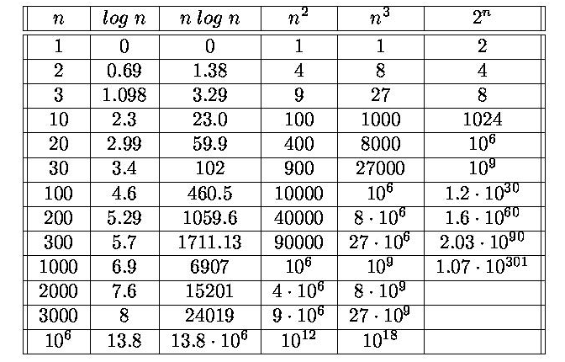
Numeric example

Slide 67
Moral of the story
Different ways of performing a computation (algorithms) can consume dramatically
different amounts of resources
(time and space)

Slide 68
Exponentiation ( b^{e} )
def power(b, e):
def power_product(a, b, e):
''' returns a * b^e '''
if (e == 0): return a
else:
return power_product(a*b, b, e-1)
return power_product(1, b, e)
Time requirement?
Space requirement?
Can we do better?
O(e)
O(e)

Slide 69
Another way to express:
1, e = 0
b^{e} = (b²)^{(e/2)}, e even
b^{e–1.}b, e odd

Slide 70
Fast Exponentiation
def fast_expt(b, e):
if e == 0: return 1
elif e%2 == 0:
return fast_expt(b*b, e/2)
else:
return b * fast_expt(b, e-1)
Time requirement?
Space requirement?
Can we do this iteratively?
O(log e)
O(log e)

Slide 71
Summary
Recursion
  Solve for a simple (base) case
  Express (divide) a problem into one or more smaller similar problems
  (Baggage to bring along)
Iteration: while / for loops
VS

Slide 72
Summary
Order of growth:
  Time and space for computations
  Different algorithms can consume dramatically different amt of resources
  Pay attention to efficiency!

Slide 73
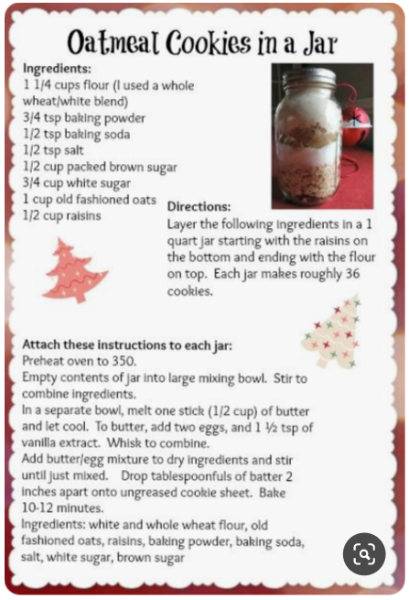
Taking stock….
Algorithm(function) vs Recipe
3 kinds of construct:
  Sequentially from top to bottom
  Conditional
  Repetitive (iterative and recursion)
Order of Growth

Slide 74
Coming up later…
CS = Algorithm + Data Structure
Data Structure
  ways of organizing data in computer to facilitate computation (execution of algorithm)
  E.g. string, set, tuple, list, dictionary, …
  (these are sequences: ordered set)
…before going into data structure abstraction,
we have more (higher order) functional abstraction

